Slide 1
Hospital Management System
DSA LAB Project
Presented By
Hafiz Muhammad Abdullah
FA20-BSE-075
Sec B

Slide 2
Introduction
The hospital management system will allow the hospital admin to perform following operations:
Book Patient appointment of following categories:
VIP
Regular
Conduction of appointments on priority basis.
Management of Hospital Doctors and Nurses.
Management of Hospital wards and ICUs.
Management of Hospital Equipment.

Slide 3
Modules or Functions
Book Patient Appointment
Conduct Appointments
Manage Hospital Doctors
Manage Hospital Nurses
Manage Hospital Wards and ICUs
Manage Hospital Equipment

Slide 4
Data Structures
Linked List.
Priority Queue.

Slide 5
File Handling
The concept of file handling is also applied to save and retrieve record from files.

Slide 6
Book Appointment Module
The hospital admin will book the appointment of patients. The patient will be asked about their:
Name
Appointment Category (VIP/Regular)
Respective OPD
The presented hospital management system will allow maximum 20 patients to book appointment in a day including 10 VIP and 10 Regular patients.
The hospital admin will look for free appointment slot in their respective category. If free slot found, appointment will be booked.
The system will assign priority to each new appointment.

Slide 7
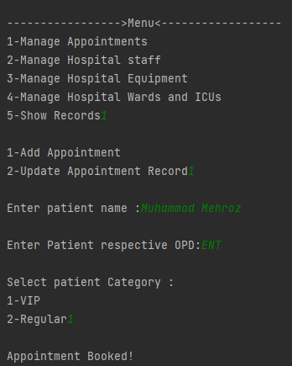
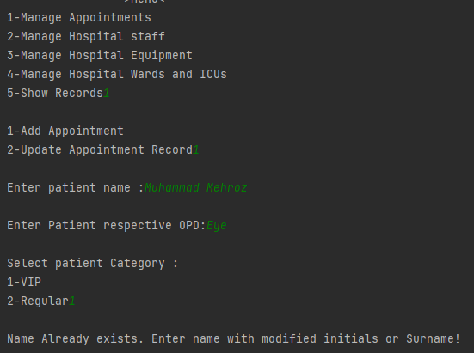
Book Appointment Console Output
The system will not allow the appointment booking of two patients with same name in same list.

Slide 8
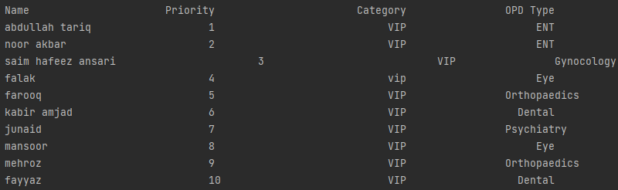
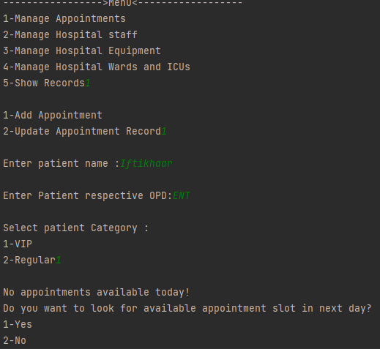
Book Appointment Console Output
Maximum 10 appointments of regular and VIP patients are allowed in a single day.

Slide 9
Conduct Appointment/Update Record Module
The conduct appointment module will allow the admin to search the patient came for appointment by their name in records.
The appointment will be conducted on priority basis of patients.
The conduct appointment module will not allow the conduction of regular appointments if VIP appointments are pending.
The system will allow the conduction of appointment only if the searched name is present on top of list and patient has lowest priority ranging from 1-10 in ascending order.

Slide 10
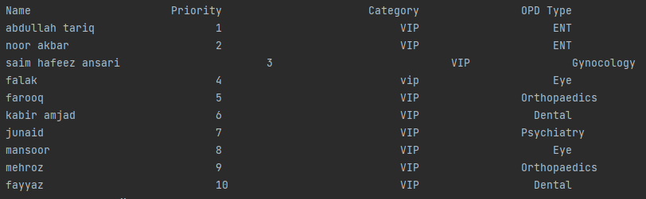
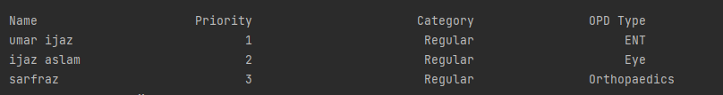
Conduct Appointment Console Output
Patients present in VIP patients Record
Patients present in Regular patients Record

Slide 11
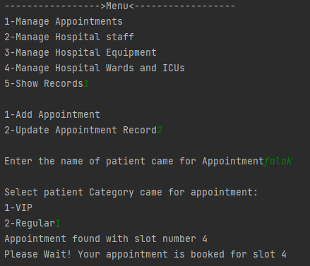
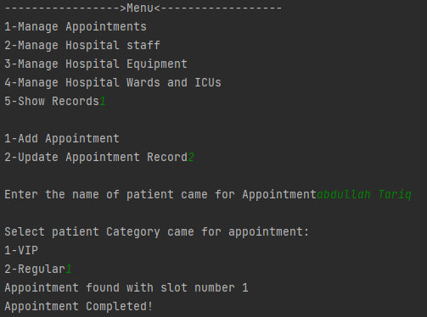
Conduct Appointment Console Output
If the searched patient is present on top of list, the appointment will be conducted.
If the searched patient is not present on top of list.

Slide 12
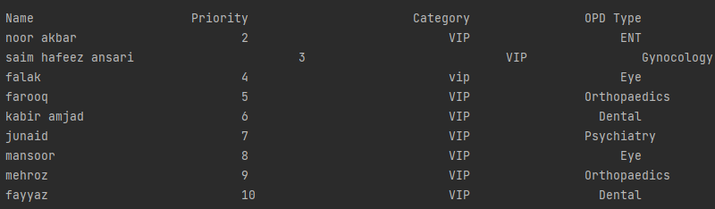
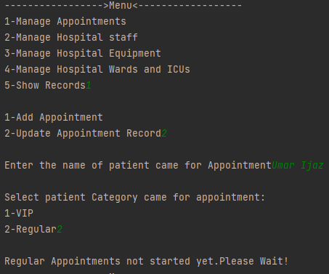
Conduct Appointment Console Output
If VIP appointments are pending, regular appointments will not be conducted.
After conduction of appointment, the patient is deleted and List Updated!

Slide 13
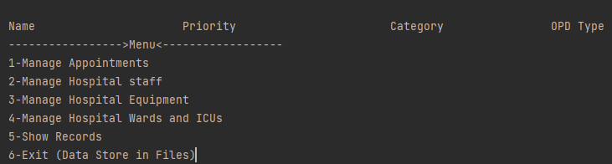
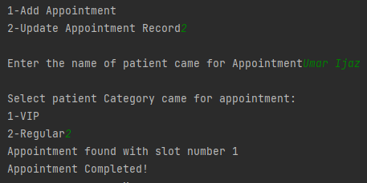
Conduct Appointment Console Output
Now the VIP Patients list is empty!
Now Regular appointments can be conducted.

Slide 14
Management of Staff Module
This module will allow the admin to update record of staff (Doctors , Nurses) .
The doctors will be entered in record on the basis of specialization.
The Nurses will be entered in record on the basis of their duty ward.
If a doctor is present in record with specific specialization and then another doctor is entered with same specialization then instead of creating a new record, the already existing record is updated.
Similarly, If a Nurse is present in record with specific working duty ward and then another Nurse is entered with same duty ward then instead of creating a new record, the already existing record is updated.

Slide 15
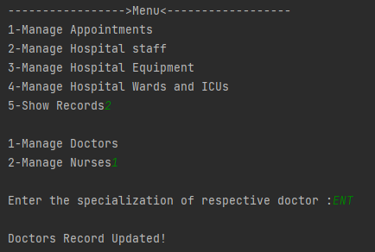

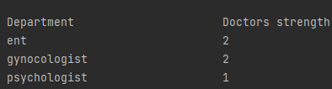
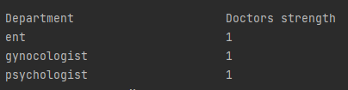
Management of Staff Console Output
If another specialist is entered with same specialization, the already existing record is updated!

Slide 16
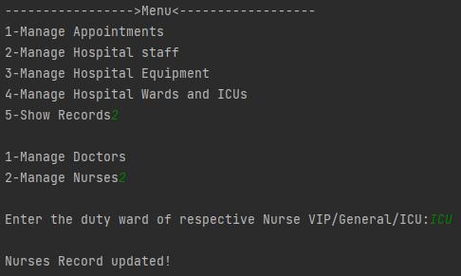

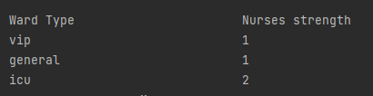
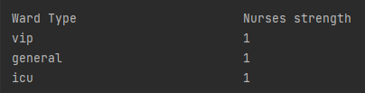
Management of Staff Console Output
If another Nurse is entered with same working duty ward, the already existing record is updated!

Slide 17
Management of Wards/ICU Module
This Module will allow the admin to manage hospital wards and ICUs.
The Hospital wards will be updated on the basis of their types.
If the record of a ward is already present in record, then the same record is incremented/updated if another ward of same type is entered.

Slide 18
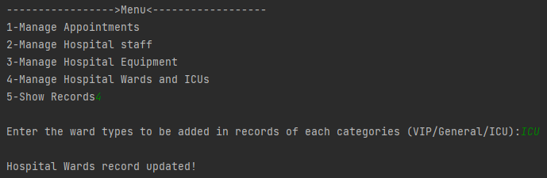


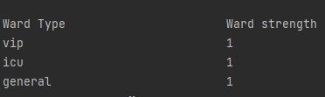
Management of Wards/ICUs Console Output
If another ward of same type is entered, then the already existing record of wards is updated!

Slide 19
Management of Hospital Equipment Module
This module will allow the admin to manage hospital equipment record.
Similar to prior modules, the already existing record of equipment is updated if another equipment is entered with same name otherwise, new record of that equipment is added.

Slide 20
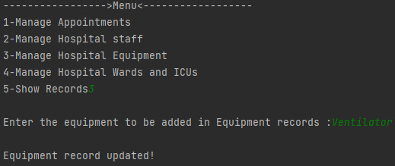


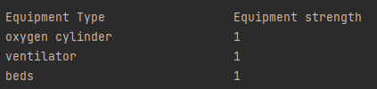
Management of Hospital Equipment Console Output
If another equipment of same name is entered, the already existing record of hospital equipment is updated!

Slide 21
Thank You!

